Slide 1
Reliability Function, Mean Time to Failure Hazard (h(t)) Instaneous failure rate
ECE 313
Probability with Engineering Applications
Ravi K. Iyer
Dept. of Electrical and Computer Engineering
University of Illinois at Urbana Champaign

Slide 2
Topics Covered
Reliability Function
Mean Time to Failure (MTTF)
Standby Redundant System
Intro to the concept of Hazard (Instanteous failure rate h(t))

Slide 3
The Reliability Function
Let the random variable X be the lifetime or the time to failure of a component. The probability that the component survives until some time t is called the reliability R(t) of the component:
where F is the CDF (Failure) of the component lifetime, X.
The component is assumed to be working properly at time t=0 and no component can work forever without failure: i.e.
R(t) is a monotone non-increasing function of t.
For t less than zero, reliability has no meaning, but: sometimes we let R(t)=1 for t<0. F(t) will often be called the unreliability.

Slide 4
The Reliability Function (Cont’d)
Consider a fixed number of identical components, N₀, under test.
After time t, N_{f}(t) components have failed and N_{s}(t) components have survived
The estimated probability of survival:

Slide 5
The Reliability Function (Cont’d)
In the limit as N₀→∞ , we expect (survival) to approach R(t). As the test progresses, N_{s}(t) gets smaller and R(t) decreases.

Slide 6
The Reliability Function (Cont’d)
(N₀ is constant, while the number of failed components N_{f} increases with time.)
Taking derivatives:
N’_{f}(t) is the rate at which components fail
As , the right hand side may be interpreted as the negative of the failure density function,
Note: then is the (unconditional) probability that a component will fail in the interval

Slide 7
Time to Failure and Reliability Function
Let T denote the time to failure or lifetime of a component in the system, and f(t) and F(t) denote the probability density function and cumulative distribution function of T, respectively.
f(t) represents the y probability density of failure at time t
The probability that the component will fail at or before time t is given by:
And the reliability of the component is the probability that the system will survive at least until time t, given by:
So we have:

Slide 8
Mean Time to Failure (MTTF)
The expected life or the mean time to failure (MTTF) of the component is given by:
Integrating by parts we obtain:
Now, since R(t) approaches zero faster than t approaches ∞, we have:

Slide 9
Exponentially Distributed Lifetime
If the component lifetime is exponentially distributed, then:
And:

Slide 10
Standby Redundancy
A standby system is one in which two components are connected in parallel, but only one component is required to be operative for the system to function properly.
Initially the power is applied to only one component and the other component is kept in a powered-off state (de-energized).
When the energized component fails, it is de-energized and removed from operation, and the second component is energized and connected in the former’s place.
If we assume that the first component fails at some time τ, then the second component’s lifetime starts at time τ and assuming that it fails at time t, its lifetime will be t – τ:
t - τ
t = 0 τ t > τ

Slide 11
Standby Redundancy (Cont’d)
If we assume that the time to failure of the components is exponentially distributed with parameters λ₁ and λ_{2,} then the probability density function for the failure of the first component is:
Given that the first component must fail for the lifetime of the second component to start, the density function of the lifetime of the second component is conditional, given by:
Then we define the system failure as a function of t and , using the definition of conditional probability:

Slide 12
Standby Redundancy (Cont’d)
The associated marginal density function of is:
So the system failure will be:
And the reliability function will be:

Slide 13
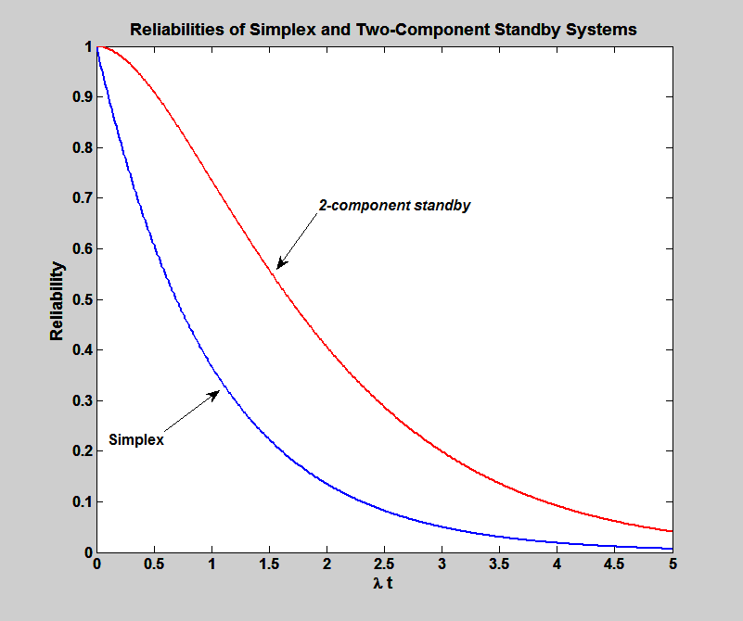
Standby Redundancy (Cont’d)

Slide 14
Instantaneous Failure Rate or Hazard Rate (h(t)
Hazard measures the conditional probability of a failure given the system is currently working.
The failure density (pdf) measures the overall speed of failures
The Hazard/Instantaneous Failure Rate measures the dynamic (instantaneous) speed of failures.
To understand the hazard function we need to review conditional probability and conditional density functions (very similar concepts)

Slide 15
Instantaneous Failure Rate
If we know for certain that the component was functioning up to time t, the (conditional) probability of its failure in the interval will (in general) be different from
This leads to the notion of “Instantaneous failure rate.” the conditional probability that the component does not survive for an (additional) interval of duration x given that it has survived until time t can be written as:

Slide 16
Instantaneous Failure Rate (Cont’d)
Definition: The instantaneous failure rate h(t) at time t is defined to be:
so that:
h(t)∆t represents the conditional probability that a component surviving to age t will fail in the interval (t,t+∆t).
The exponential distribution is characterized by a constant instantaneous failure rate:

Slide 17
Instantaneous Failure Rate (Cont’d)
Integrating both sides of the equation:
(Using the boundary condition, R(0)=1) Hence:

Slide 18
Cumulative Hazard
The cumulative failure rate, , is referred to as the cumulative hazard.
gives a useful theoretical representation of reliability as a function of the failure rate.
An alternate representation gives the reliability in terms of cumulative hazard:
If the lifetime is exponentially distributed, then and we obtain the exponential reliability function.
(Using the boundary condition, R(0)=1) Hence:

Slide 19
f(t) and h(t)
f(t)∆t is the unconditional probability that the component will fail in the interval (t,t+ ∆t]
h(t) ∆t is the conditional probability that the component will fail in the same time interval, given that it has survived until time t.
h(t) is always greater than or equal to f(t), because R(t)≤1.
f(t) is a probability density. h(t) is not.
[h(t)] is the failure rate
[f(t)] is the failure density.
To further see the difference, we need the notion of conditional probability density.

Slide 20
Failure Rate as a Function of Time

Slide 21
Constraints on f(t) and z(t)

Slide 22
Conditional Probability Density Function
Let denote the conditional distribution of the lifetime X given that the component has survived past fixed time t. Then
Note that Then the conditional failure density is:

Slide 23
Conditional Probability Density Function (Cont’d)
The conditional density satisfies properties (f1) and (f2) of a probability density function (pdf) and hence is a probability density while the failure rate h(t) does not satisfy property (f2) since:

